Slide 1

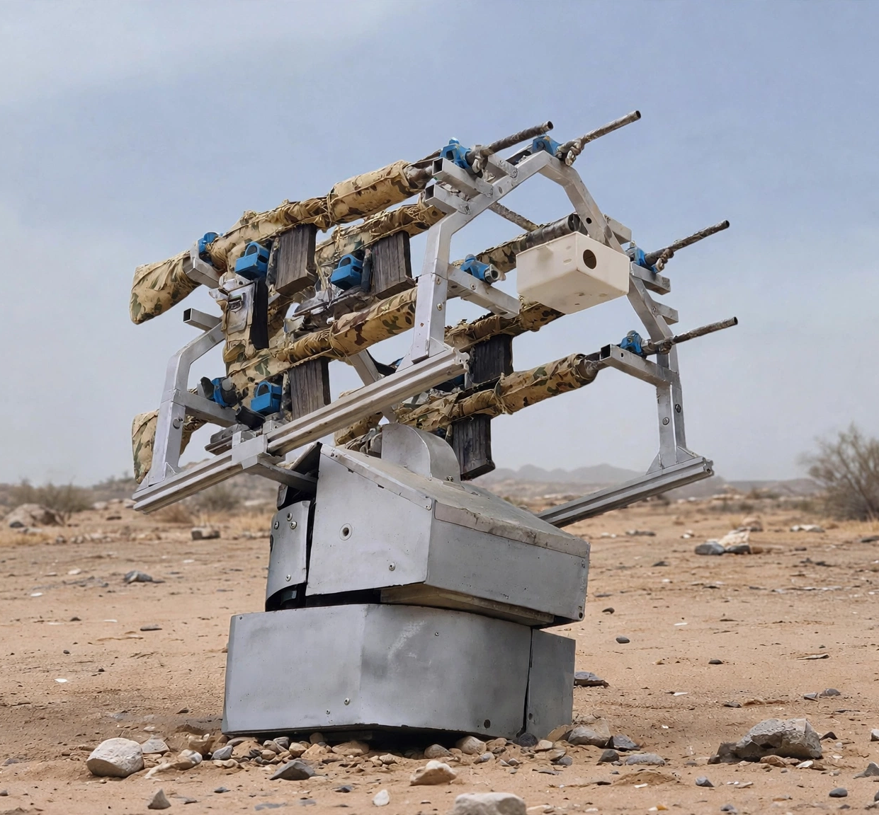
S.T.R.I.K.E.
AI-Powered Counter-UAS Platform Family
Platform Capability Definition
Smart Targeting,
Reconnaissance and
Intelligent Kill Engagement
Designed & Developed By
ANMAY DEFENCE
Engineering the Future of Autonomous Airspace Security

Slide 2


About Anmay Defence
Who We Are
Core Areas
Anmay Defence, a brand name of Anmay Autonomous Systems Pvt. Ltd., develops indigenous AI-powered autonomous defence technologies designed to enhance airspace security through intelligent surveillance, autonomous tracking, and modular counter-UAS platforms.
Counter-UAS Systems
Artificial Intelligence
Embedded Electronics
Autonomous System
Computer Vision
Defence Communication Systems
Electronic Warfare Integration

Slide 3

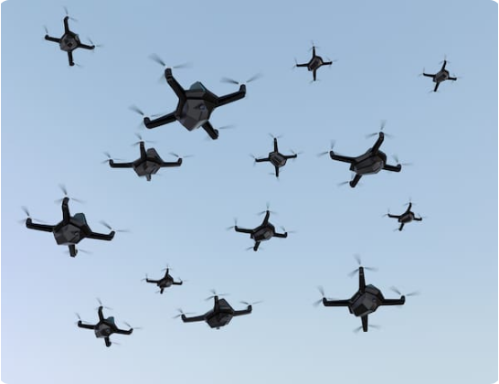
The Modern Drone Threat
Today's battlefields are rapidly evolving with the widespread use of commercial and military unmanned aerial systems. Conventional surveillance solutions often struggle against low-altitude, high-speed, and swarm drone attacks.
Key Challenges
Swarm Attacks
Autonomous Nav
Low Altitude
Long Range
Small Radar CS
Electronic Warfare

Slide 4
STRIKE Product Family
Generation 01
STRIKE Gen1
1-Layer Defence Protection System
AI Vision
Autonomous Tracking
Rapid Deployment
Modular Architecture
360° Surveillance
Rapid Deployment
Static & Vehicle Mounting
Generation 02
STRIKE Gen2
2-Layer Defence Protection System
Gen 1 capabilities plus:
Extended Detection Range
Day & Night Vision
LiDAR-Assisted Target Identification
Integrated Electronic Warfare
Long-Range Operations
5 km Optical Fiber Control
2 km Wireless Video Transmission
Generation 03
Future Generations
Gen 2 + Next-Gen Architectures
Directed energy integration
Swarm defeat logic
Full autonomous networks
Compatible with moving vehicle
Drone Integration from Long range Surveillance
Currently in Research & Development Stage

Slide 5
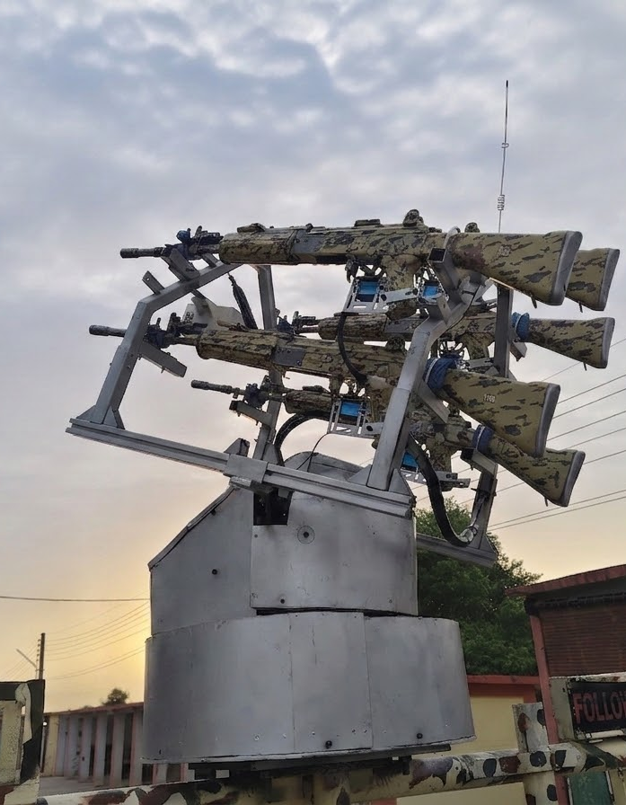
STRIKE Gen1
Platform Overview
STRIKE Gen 1 represents the next generation of indigenous Counter-UAS technology, combining AI-driven situational awareness, autonomous target tracking, precision engagement, and modular mission configurations within a scalable defence platform. Built on an open and upgradeable architecture, STRIKE Gen 1 enables the seamless integration of advanced sensors, electronic warfare systems, and future mission capabilities to meet evolving operational requirements.
PRICE
₹ XXX
LEAD TIME
35 Days

Slide 6

Gen1 Technical Specifications
Detection Range
700 m (10ft + Drone)
Rotation
360° Continuous
Drone Types
Quadcopter, VTOL, Fixed Wing
Elevation
75°
Communication
LoRa(+1km), WiFi, BLE
Trigger Units
5 Independent Rifles
Power Requirement
24VDC
Deployment Time
<10 Minutes
Mounting Options
Vehicle Mount
Operation Modes
Auto / Manual Modes
Protection Layer
1 Layer (Kinetic)
Made in India
Fully indigenous development, ensuring supply chain security and sovereignty.

Slide 7
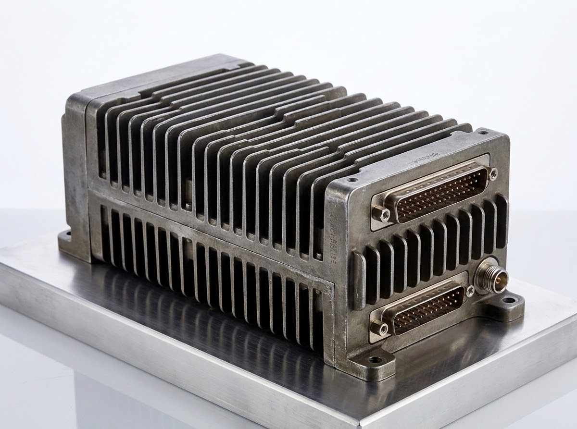
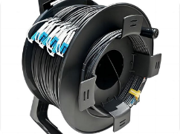
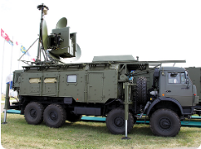
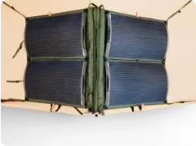
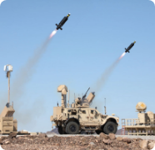
Gen1 Mission Packages
RF Early Warning
Detects drone communication signals from over 2 km, triggering automated AI tracking to optimize power consumption.
Optical Fiber
Provides secure, jammer-resistant command links and live HD video transmission over distances exceeding 5 km.
Electronic Warfare
Delivers advanced radio frequency counter-measures and signal disruption in contested tactical environments.
Solar Power
Extends tactical mission endurance using high-efficiency, rapidly deployable solar harvesting units.
Multi-Weapon
Supports multiple independent weapon configurations for enhanced engagement capability.
MODEL
STRIKE RF
MODEL
STRIKE OF
MODEL
STRIKE EW
MODEL
STRIKE SP
MODEL
STRIKE M
Modular capability upgrades that can be integrated with STRIKE Gen1 to enhance mission effectiveness and operational flexibility.

Slide 8
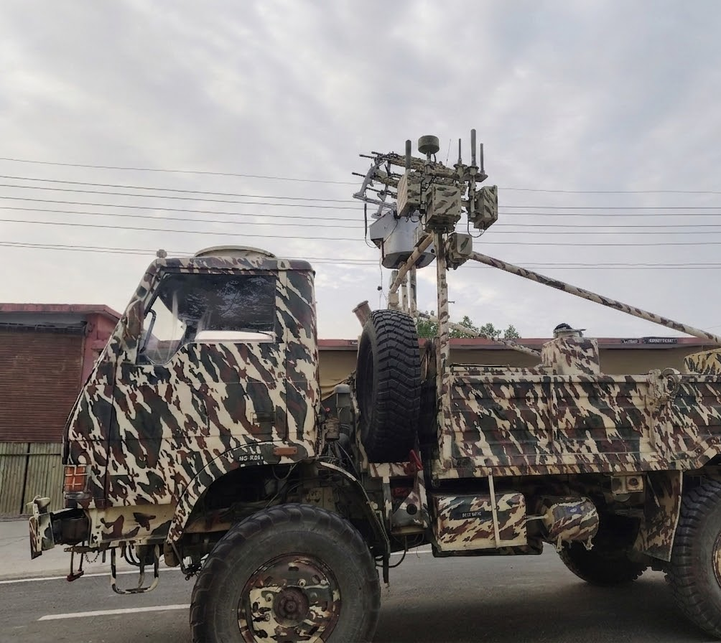
RF Early Warning Package
Overview
The RF Early Warning Package detects drone communication signals from distances exceeding 2 km. Upon detecting an RF signature, the AI vision system automatically activates, enabling faster target acquisition while significantly reducing overall power consumption.
Features
2 km+ RF Detection Range
Automatic AI Activation
Early Threat Warning
Lower Power Consumption
Extended Mission Endurance
PRICE
XXX
LEAD TIME
35 Days

Slide 9
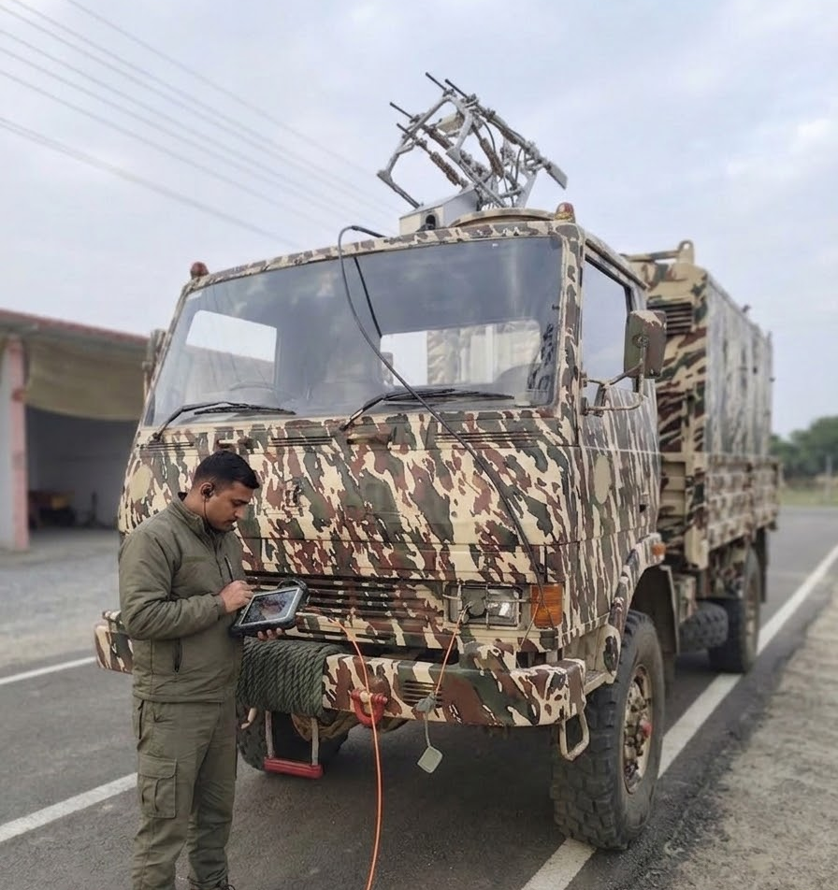
Optical Fiber Package
Overview
Provides secure optical fiber-based command, control, and live video transmission over distances exceeding 5 km, ensuring uninterrupted operation in electronically contested environments where wireless communication may be Jammed.
Features
5 km+ Secure Fiber Link
Jammer Resistant Comms
Live High-Def Video
Ultra-Low Latency
Secure Encrypted Communication
PRICE
₹ XXX
LEAD TIME
15 Days

Slide 10
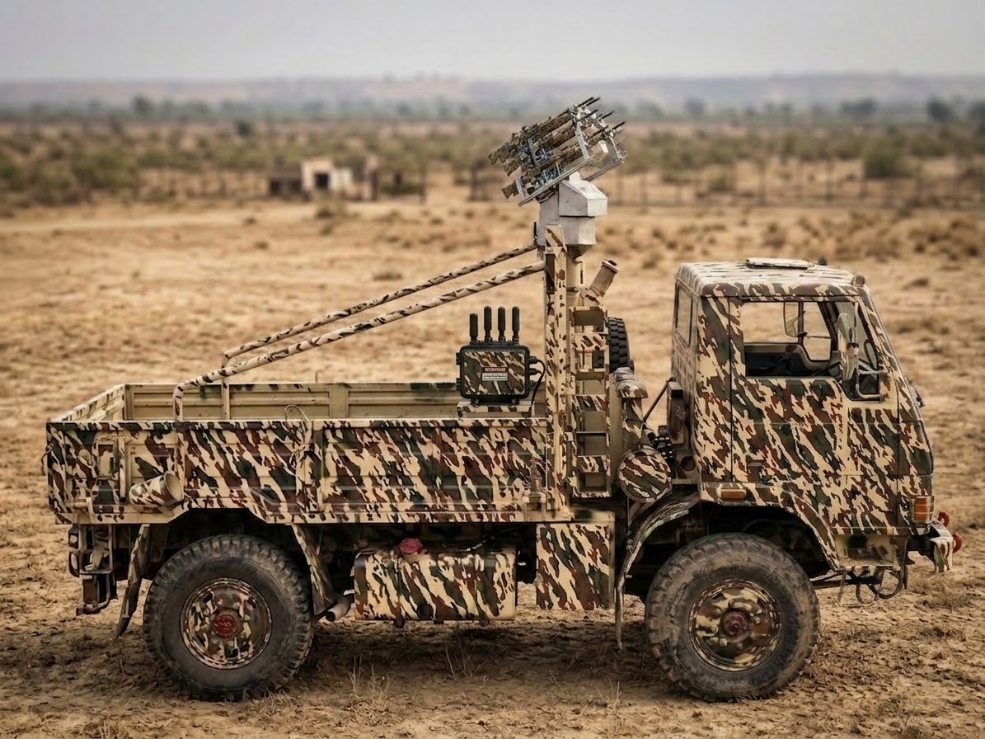
Electronic Warfare Package
Overview
Enhances STRIKE with integrated RF jamming capability to disrupt hostile drone communication and navigation links, providing a critical additional non-kinetic layer of protection for the defended airspace.
Features
Multi-Band Signal Jamming
Configurable Frequencies
Layer-2 Non-Kinetic Protection
Modular Integration Design
PRICE
₹ XX
LEAD TIME
45 Days

Slide 11

Solar Power Package
Overview
Integrates solar charging and intelligent battery management, enabling continuous, sustained operation in remote forward areas without access to conventional power infrastructure or generators.
Features
24×7 Continuous Operation
High-Efficiency Solar Charging
Intelligent Battery Management
Ideal for Remote Deployment
PRICE
₹ XX
LEAD TIME
20 Days

Slide 12
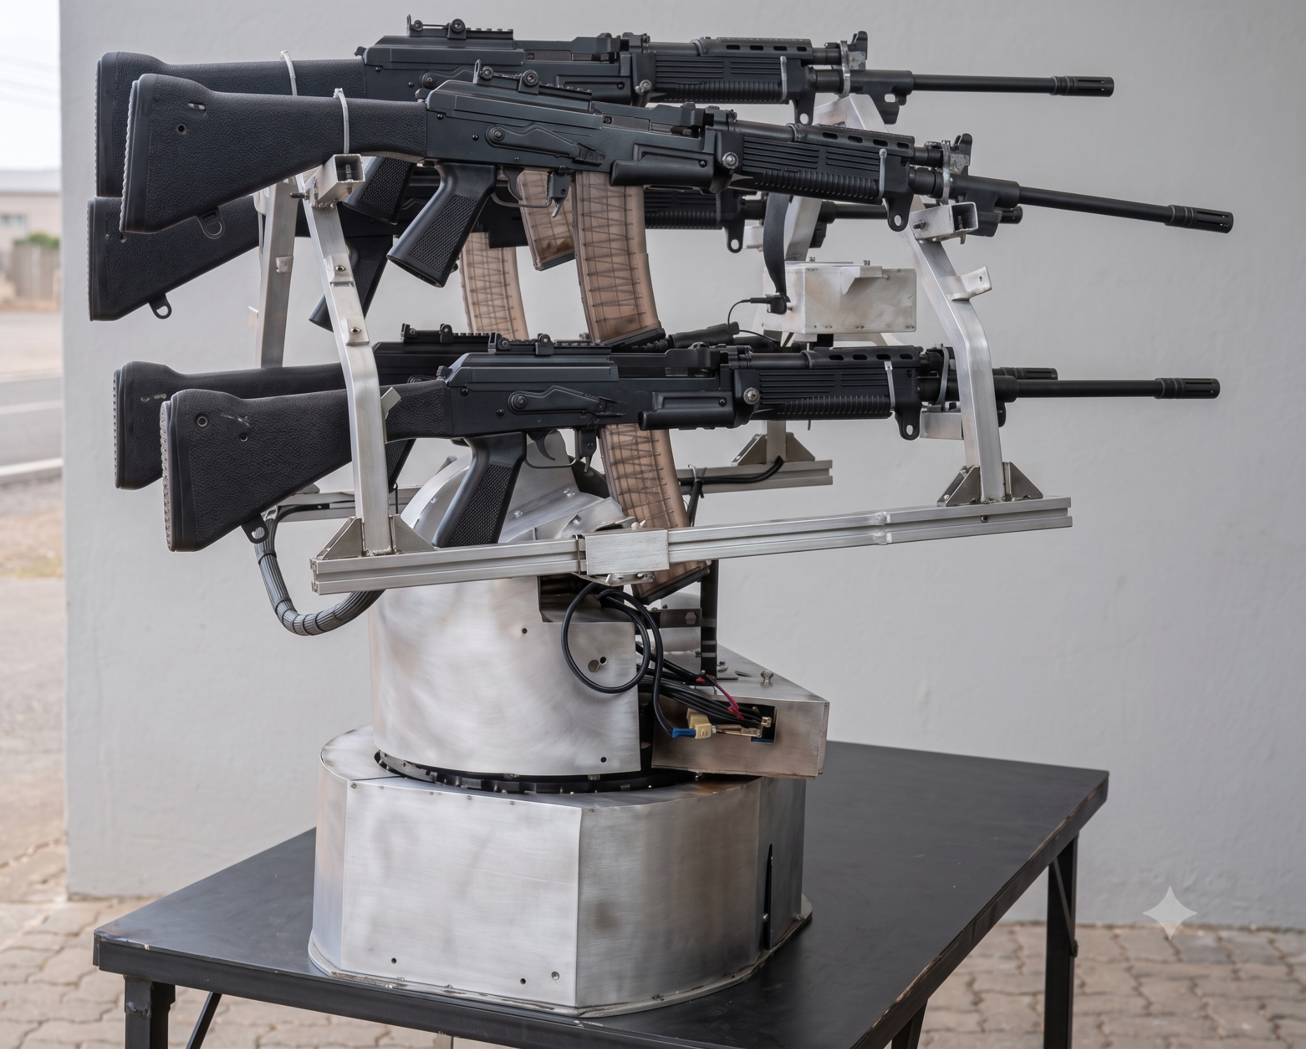
Multi-Weapon Package
Overview
Supports multiple weapon configurations through a modular mounting architecture with independent trigger control. This flexibility allows for rapid adaptation to mission-specific requirements, ranging from kinetic engagement to less-lethal countermeasures.
Compatible with multiple weapon platforms, including INSAS, AK-203, LMG, MMG, and other compatible assault weapon systems.
LMG
PRICE
₹ XX
LEAD TIME
35 Days

Slide 13

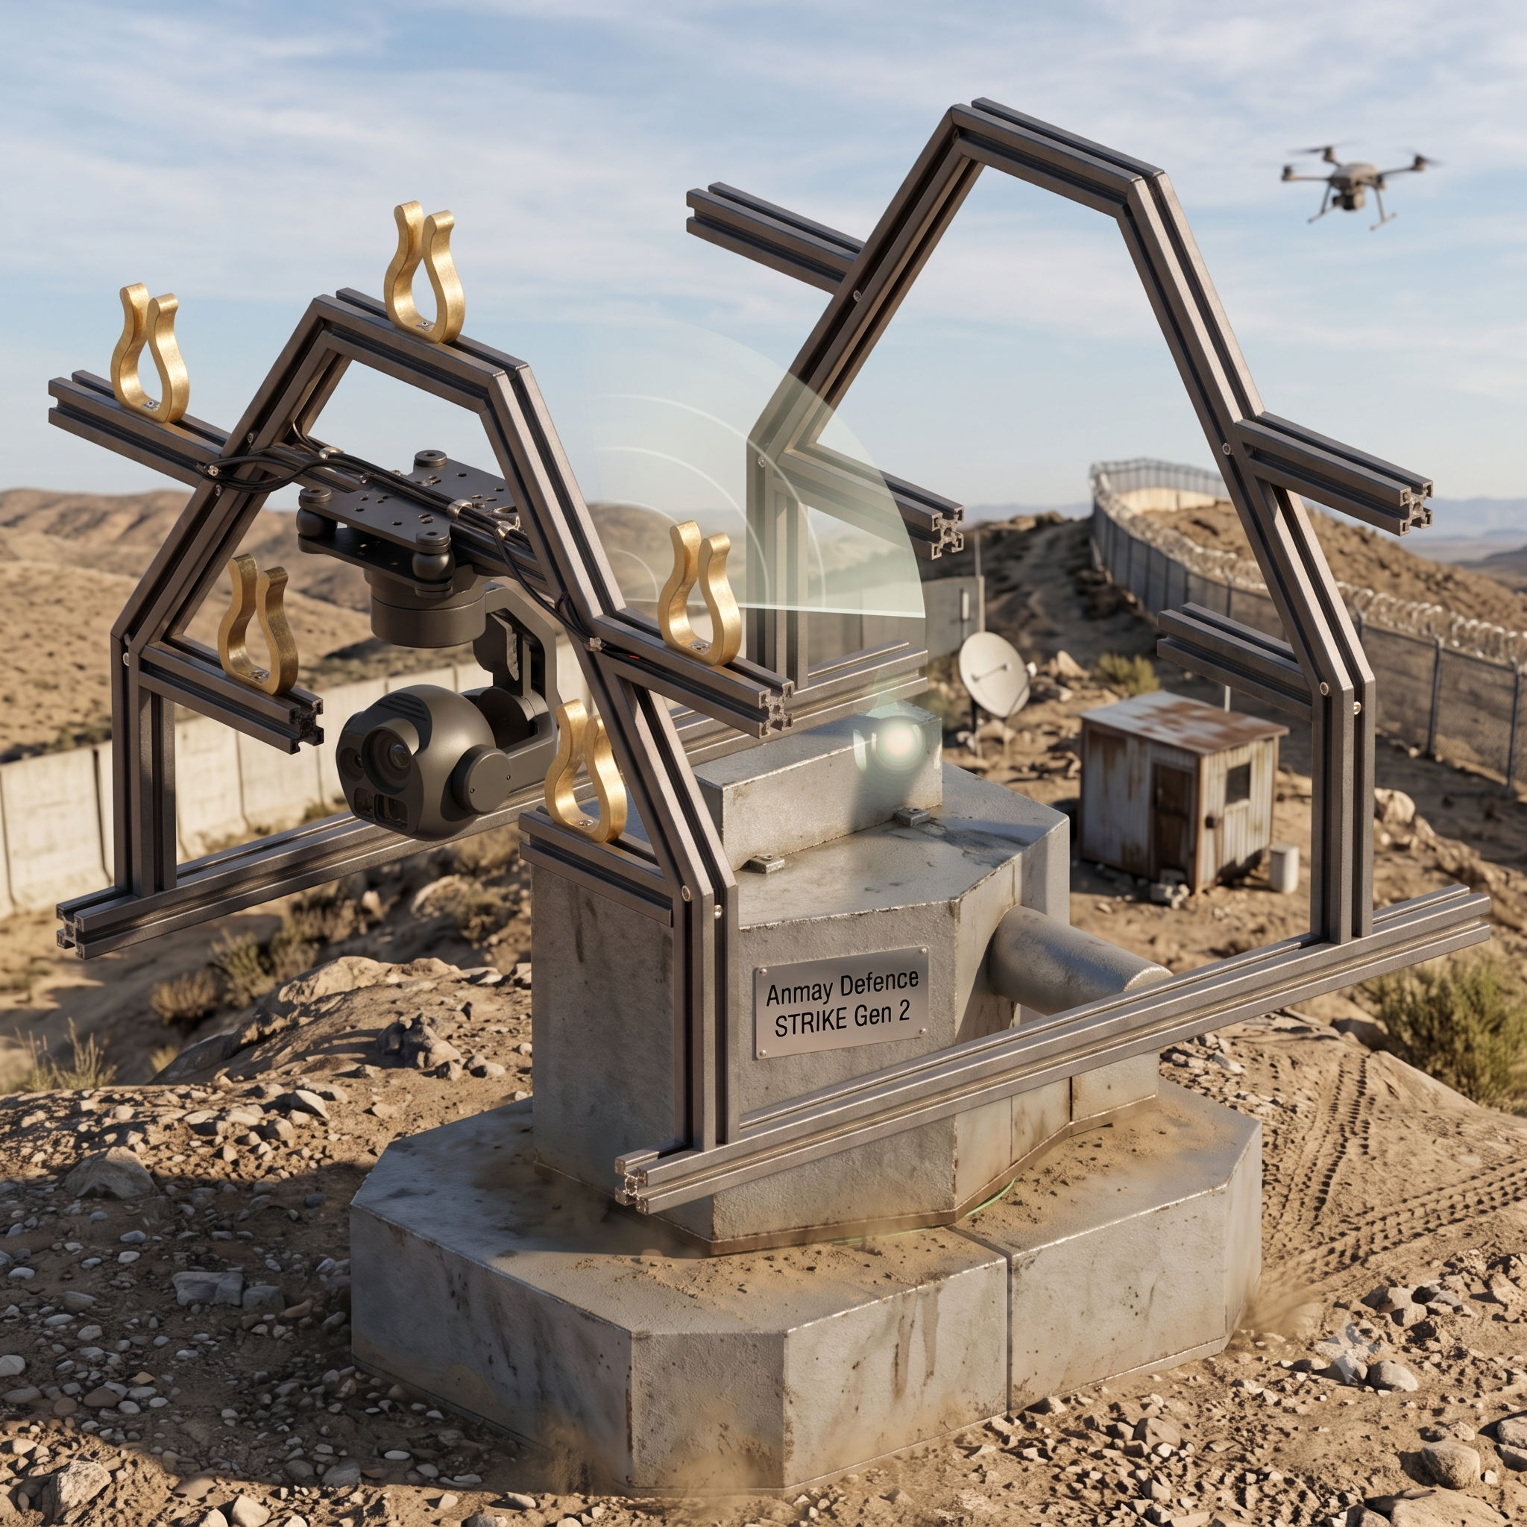
STRIKE Gen2
Next-Generation AI Counter-UAS Platform
STRIKE Gen2 builds upon the proven STRIKE Gen 1 platform with next-generation sensing, Edge AI computing, and layered defence capabilities. Integrating Day & Night vision, LiDAR-assisted target identification, electronic warfare, and extended-range operations, it delivers enhanced situational awareness, faster target acquisition, and greater mission effectiveness. Its modular and scalable architecture supports seamless integration of future sensors, mission systems, and Counter-UAS technologies.
PRICE
₹ XXX
LEAD TIME
45 Days

Slide 14
STRIKE Gen2: What's New
Designed for the most demanding multi-domain threat environments.
Sensing & Optics
Intelligence & Control
Comms & Protection
Camera System
Day & Night PTZ
AI Architecture
NVIDIA Edge
Comms (LoRa/Fiber)
2 km / 5 km
Optical Zoom
30×
Video Transmission
2 km Wireless
Trigger Units
5 Independent
Detection Range
+ 1.5 km
Power / Deployment
24VDC / <10 Min
Rotation / Elevation
360° / 80°
LiDAR
Integrated
Protection Layer
2 (Kinetic + Jamming)

Slide 15
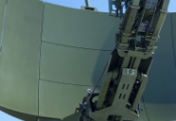
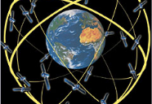
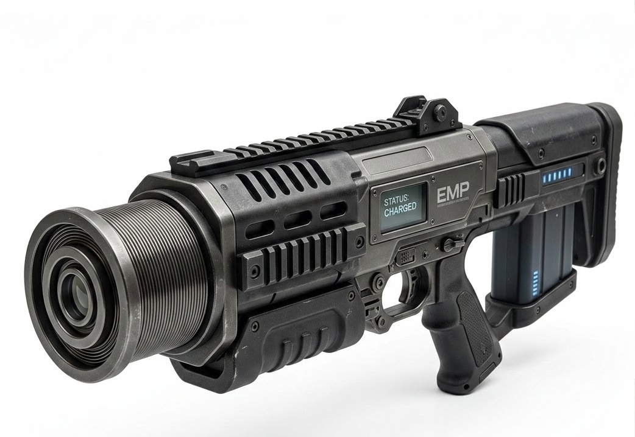
Gen2 Mission Packages
Solar Power
Extends tactical mission endurance using high-efficiency, rapidly deployable solar harvesting units.
Multi-Weapon
Supports multiple independent weapon configurations for enhanced engagement capability.
Radar Surveillance
Long-range radar for early detection and automatic target cueing.
GPS Spoofing
Disrupts hostile UAV navigation through controlled GNSS signal manipulation.
EMP
Integrates electromagnetic payloads for advanced electronic threat neutralization.
MODEL
STRIKE 2 SP
MODEL
STRIKE 2 M
MODEL
STRIKE 2 RS
MODEL
STRIKE 2 GS
MODEL
STRIKE 2 EMP
Modular capability upgrades that can be integrated with STRIKE Gen2 to enhance mission effectiveness and operational flexibility.

Slide 16
Solar Power Package (Gen2)
Overview
Integrates solar charging and intelligent battery management, enabling continuous, sustained operation in remote forward areas without access to conventional power infrastructure or generators.
Features
24×7 Continuous Operation
High-Efficiency Solar Charging
Intelligent Battery Management
Ideal for Remote Deployment
PRICE
XX
LEAD TIME
20 Days

Slide 17
Multi-Weapon Package
Overview
Supports multiple weapon configurations through a modular mounting architecture with independent trigger control. This flexibility allows for rapid adaptation to mission-specific requirements, ranging from kinetic engagement to less-lethal countermeasures.
Compatible with multiple weapon platforms, including INSAS, AK-203, LMG, MMG, and other compatible assault weapon systems.
LMG
PRICE
₹ 1 - 3 Lakhs
LEAD TIME
35 Days

Slide 18
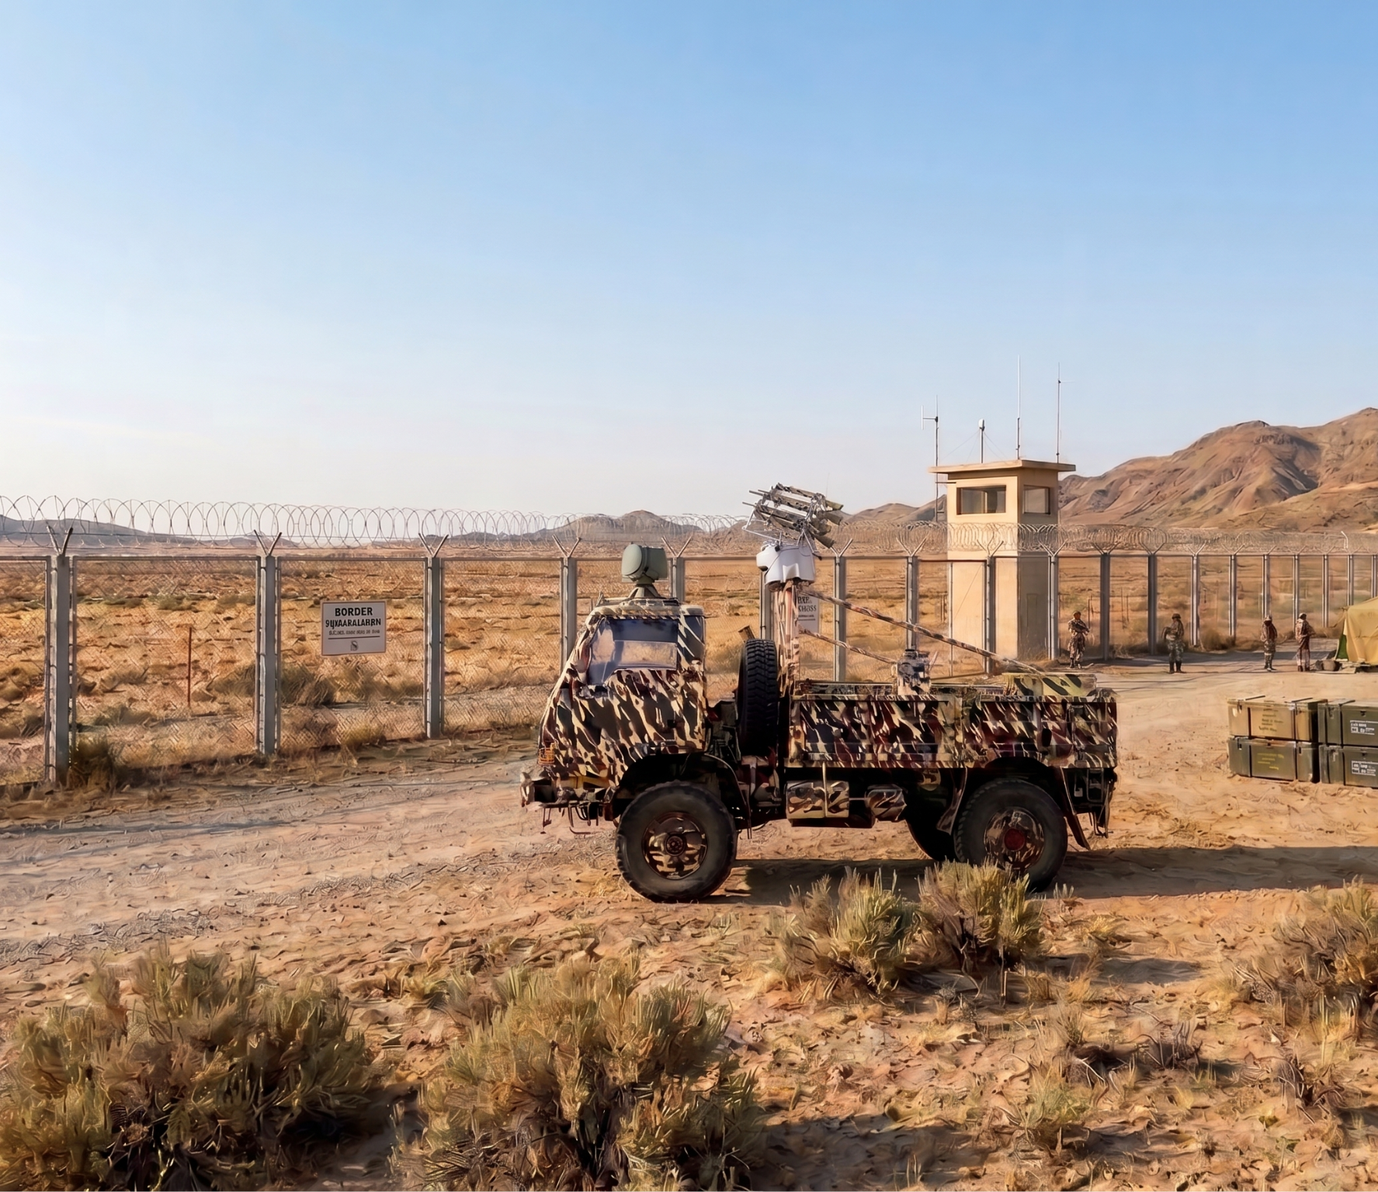

Radar Package
Overview
The Radar Package integrates a long-range radar system that continuously scans the surrounding airspace, providing early target detection and automatic cueing of the electro-optical tracking system. This enhances performance in complex environments.
Features
Long-Range Radar Detection
Continuous Airspace Monitoring
Automatic AI Cueing
All-Weather Detection
Enhanced Situational Awareness
PRICE
XX
LEAD TIME
90 Days

Slide 19
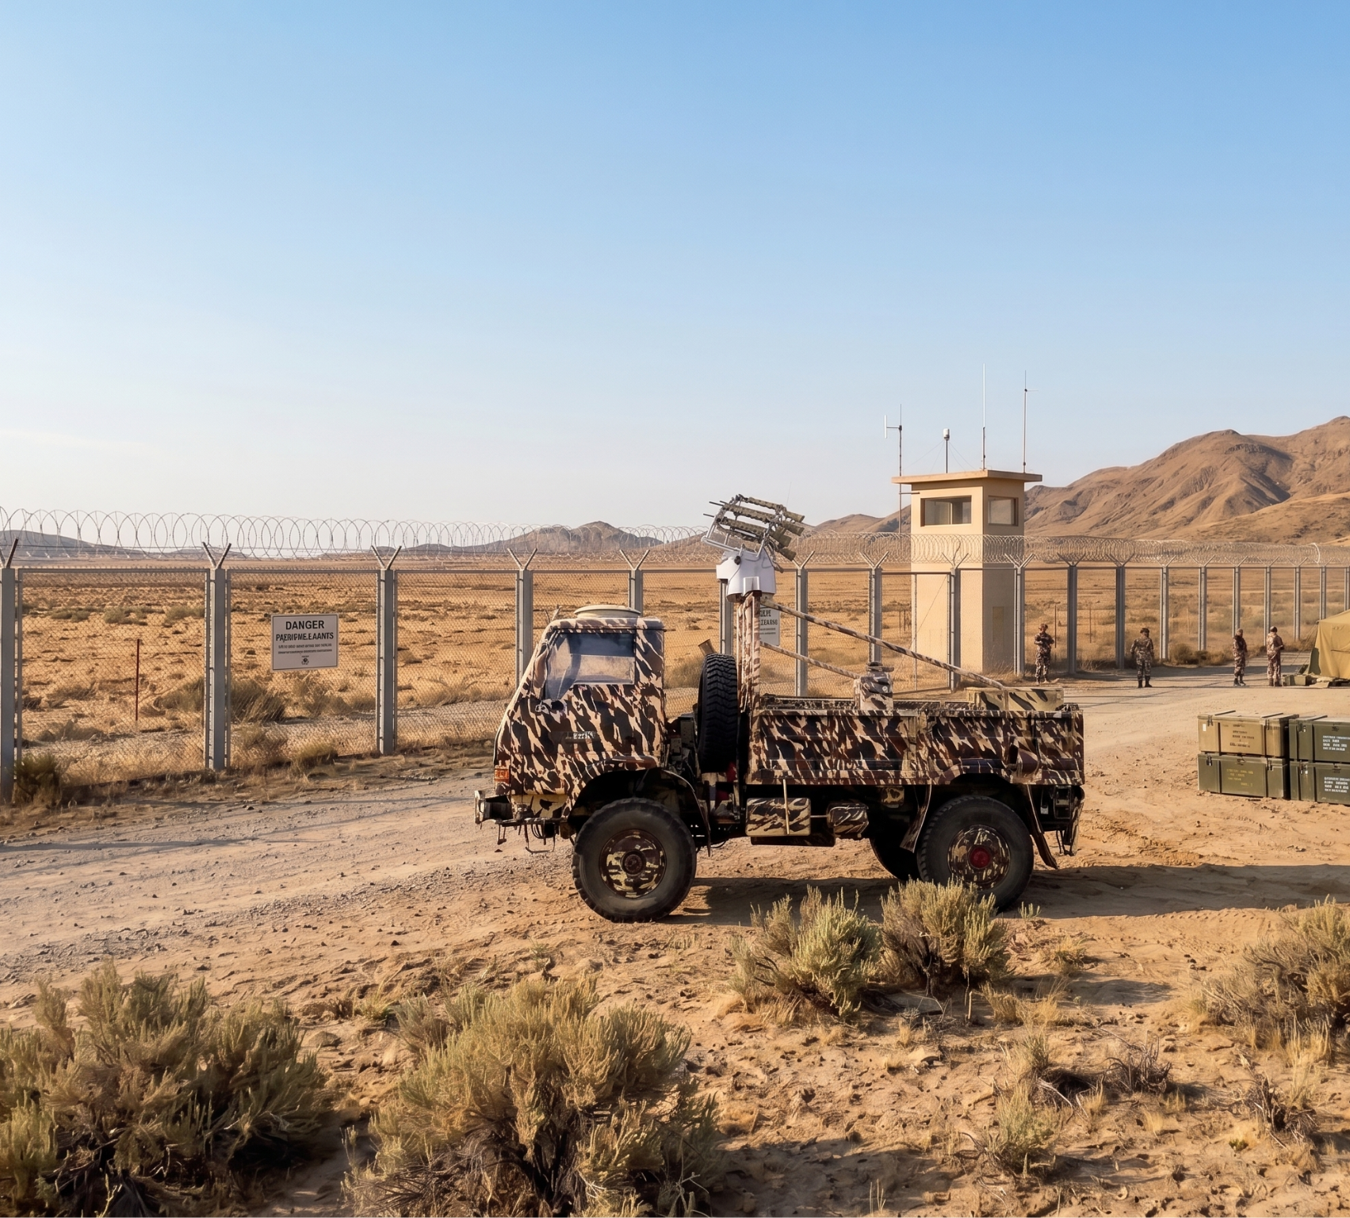
GPS Spoofing Package
Overview
The GPS Spoofing Package integrates advanced GNSS countermeasure capabilities to enhance the platform's layered Counter-UAS defence architecture against navigation-dependent aerial threats.
Key Features
gps_fixed
GNSS Countermeasure Integration
extension
Modular Plug-and-Play Architecture
speed
Rapid Deployment & Mission Configuration
layers
Compatible with Layered Counter-UAS Operations
PRICE
XX
LEAD TIME
65 Days

Slide 20

EMP Package
Overview
Enables integration of future high-energy electromagnetic payloads, enhancing STRIKE with next-generation non-kinetic Counter-UAS capabilities through a modular and upgradeable architecture.
Key Features
bolt
Future-Ready EMP Integration
power
Modular Mission Payload Interface
shield
Advanced Non-Kinetic Defence
developer_board
Scalable Power & Control Architecture
settings_input_component
Open System Design
speed
Rapid Mission Configuration
upgrade
Upgradeable Capability Framework
PRICE
₹ –
LEAD TIME
–

Slide 21










Why S.T.R.I.K.E.
Indigenous Technology
AI Powered
Modular
Layered Protection
Upgrade Ready
Rapid Deployment

Slide 22
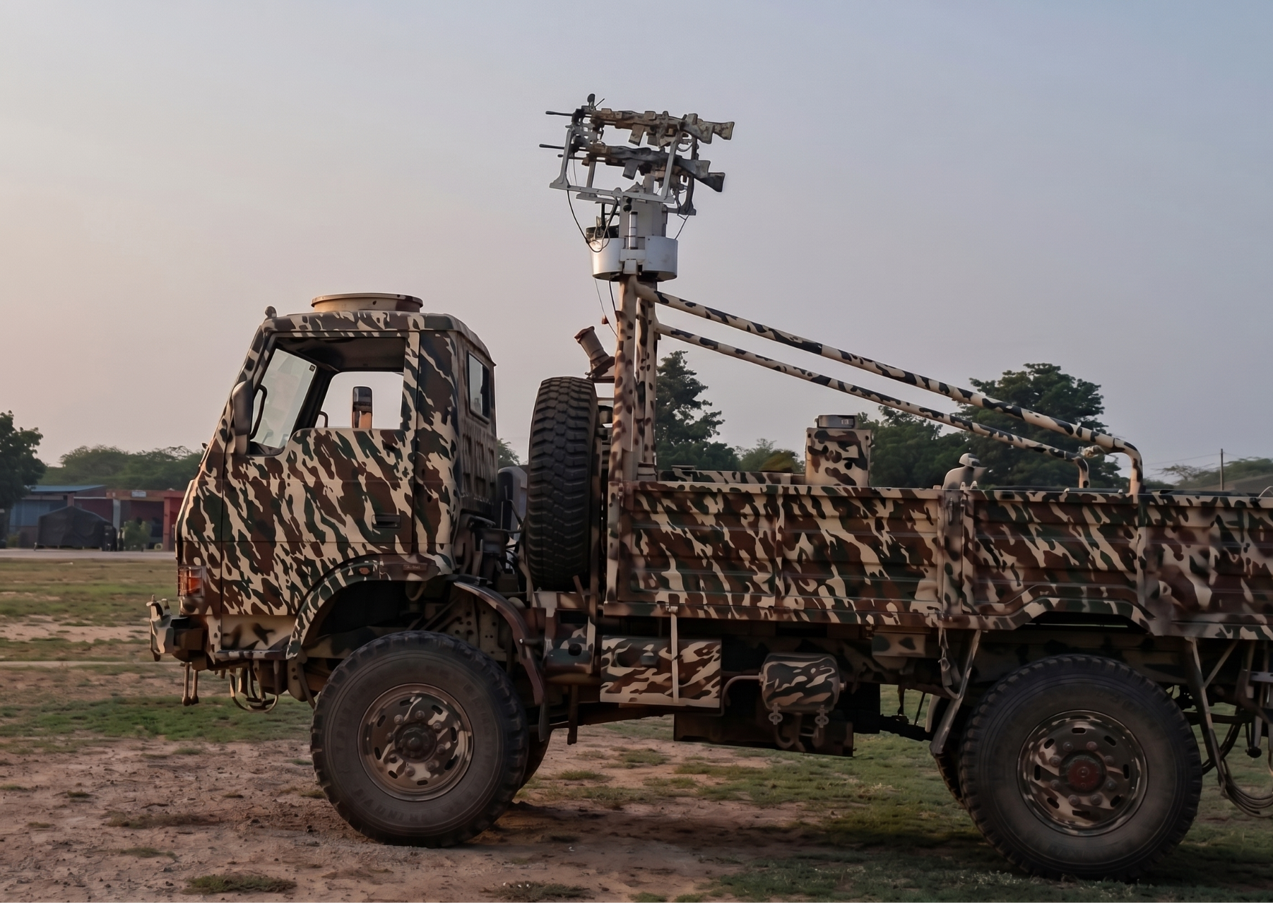
Autonomous Airspace Security
STRIKE
AI-Powered Counter-UAS Platform Family
Designed & Developed By
ANMAY DEFENCE
Engineering the Future of Autonomous Airspace Security
phone +91 8828959943| emailANMAYDEFENCE@GMAIL.COM| placeMUMBAI, INDIA

